Slide 1
Glove Drummer
MIDI Controller and Audio Playback System
Group 15:
Aaron Rice (EE)
Timothy Cox (CpE)
Michael Moran (EE)

Slide 2
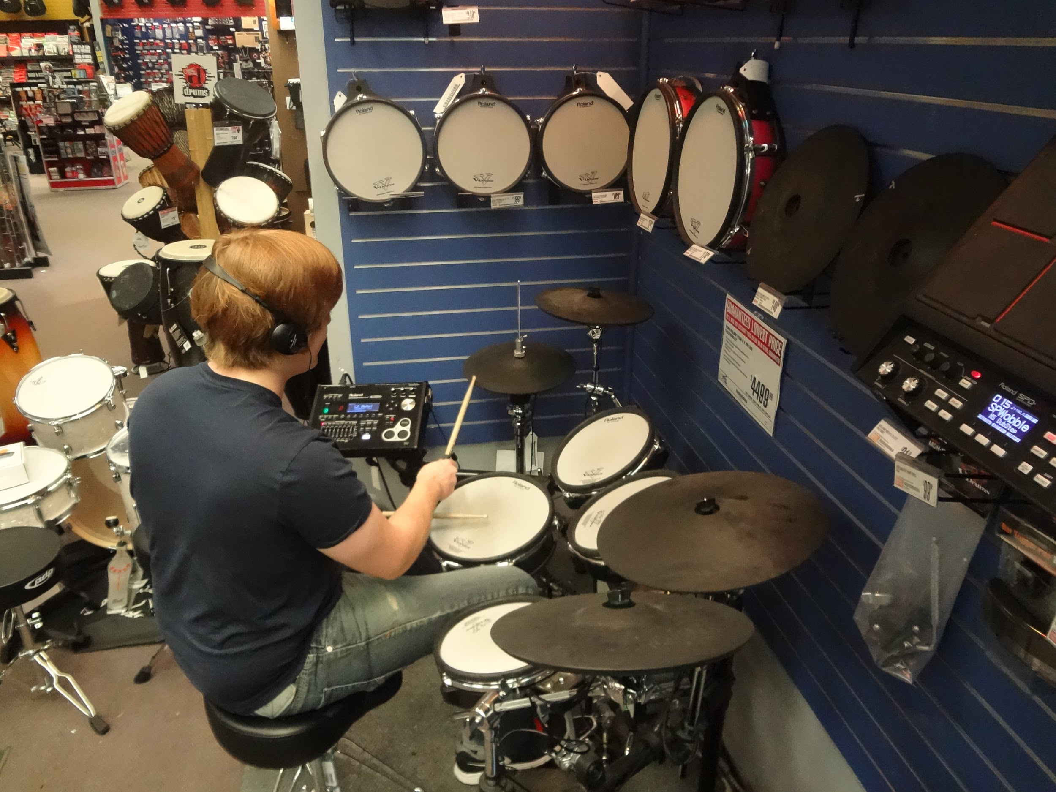
Thanks to Guitar Center !

Slide 3
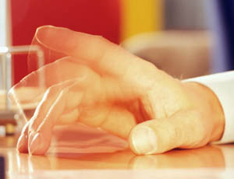
Motivation
Urge to tap hands or fingers along to music
To intuitively map a drum set to different parts of the hand
To shrink to size of an electronic drum kit, allowing drummers to practice almost anywhere

Slide 4
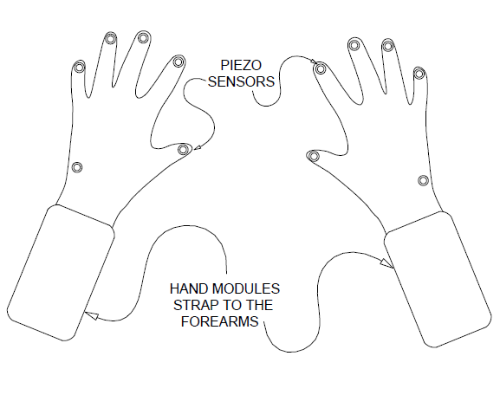
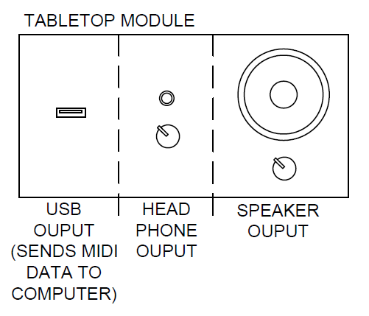
High Level View

Slide 5
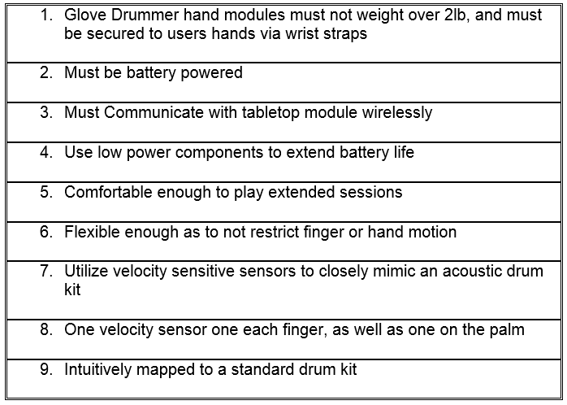
Hand Module Specifications

Slide 6
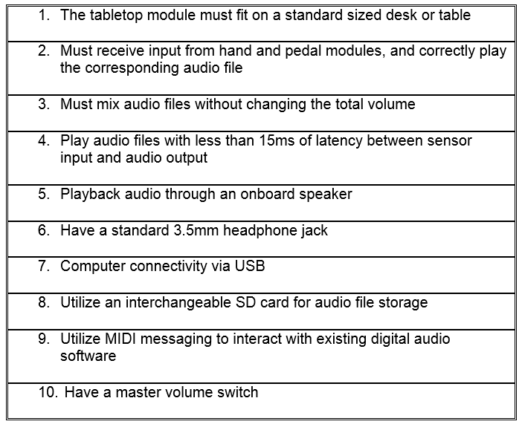
Tabletop Module Specifications

Slide 7
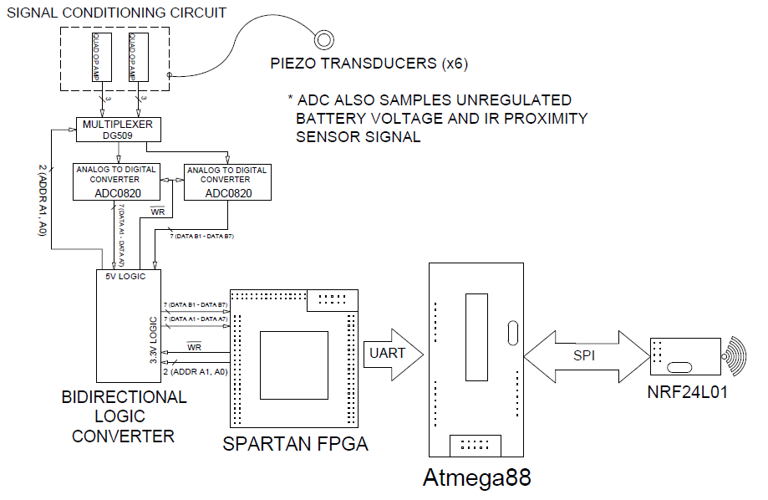
Inside the Hand Modules

Slide 8
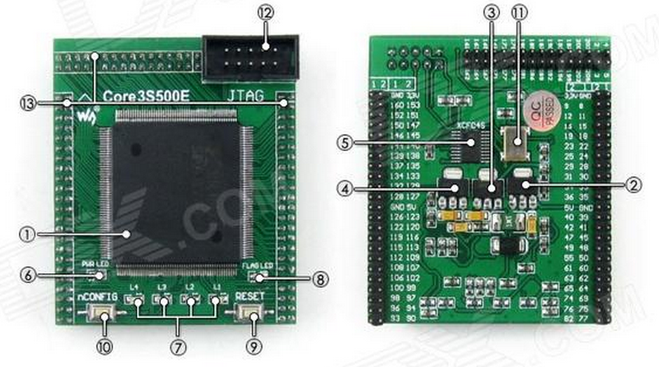
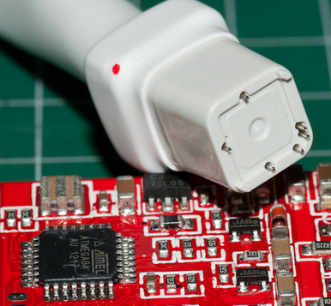
Hand Module FPGA and MCU
Spartan FPGA XC3S500e dev board
$35 on eBay
made to be plugged into another PCB
Wireless prototyping components
ATmega88 dev boards (x2), nRF modules (x2), USBasp programmer all obtained from eBay for a total cost less than $20
ATmega88 QFP-32 to be used on PCB and programmed with a special QFP adapter for the USBasp

Slide 9
Piezoelectric Sensors
Reinforced by foam and brass disks (diameter = 1cm)
Soldered carefully with respect to Curie Temperature

Slide 10
The Piezo Signal
Magnitude of voltage response is proportional to how hard the sensor is struck

Slide 11
Signal Conditioning
High output impedance of the piezo is a concern
Signal must be bound between zero and 5V in order to interface with the ADC0820
Bandpass filter centered around piezo’s resonant frequency reduces noise

Slide 12
Selecting an Op Amp
Large selection of free samples
Cost not a major factor in decision, in contrast to ADC

Slide 13
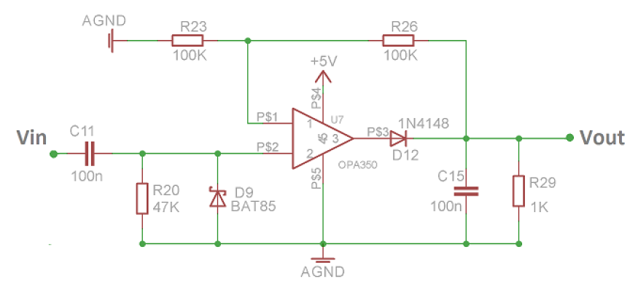
The Conditioning Circuit

Slide 14
The Conditioned Signal
Signal rapidly peaks and then dies out long before the finger has another chance to tap the sensor

Slide 15
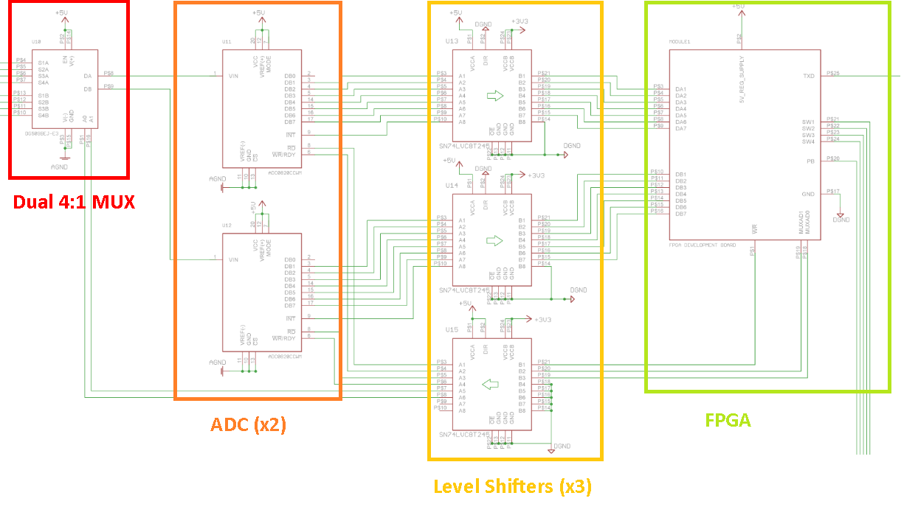
Acquiring Sensor Data

Slide 16
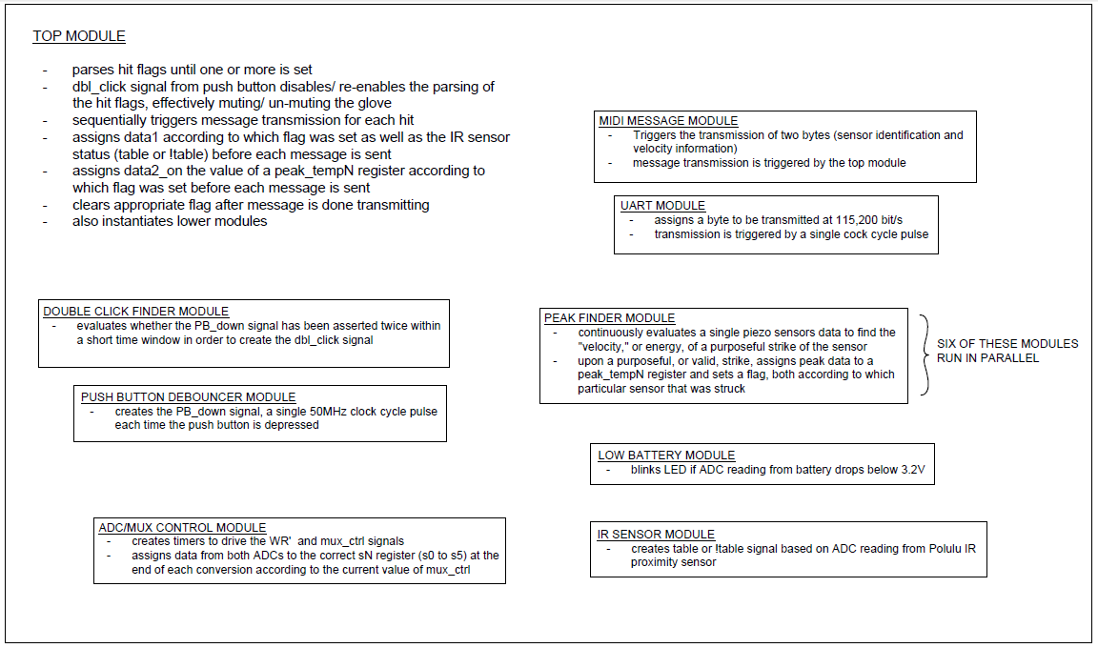
Verilog Modules

Slide 17
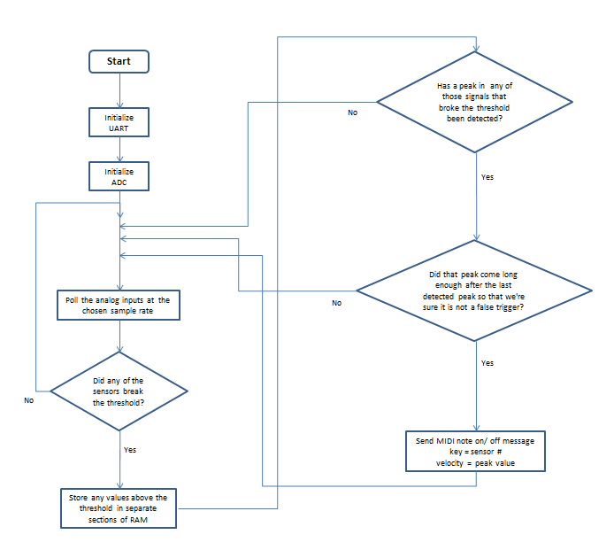
Finding Hits
State Machine waits ~1ms after threshold is surpassed to send hit message and another ~30ms before beginning to look for a new hit or peak
Using an FPGA allows each piezo to have two dedicated hardware timers for this purpose

Slide 18
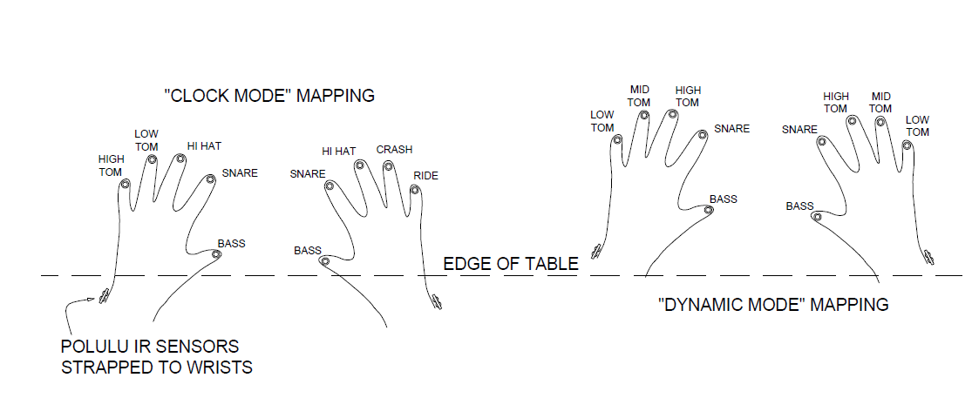
Drum Fills
Can’t bounce the fingers like a drumstick on a skin
Can change mapping sensor to drum mapping with the help of a Polulu IR sensor
More or less two discrete outputs

Slide 19
Transmitting Hit Information
Only need to transmit two bytes per hit
byte #1 = data1 = sensor identification
byte #2 = data2 = velocity
Compare # of bytes to MIDI running status

Slide 20
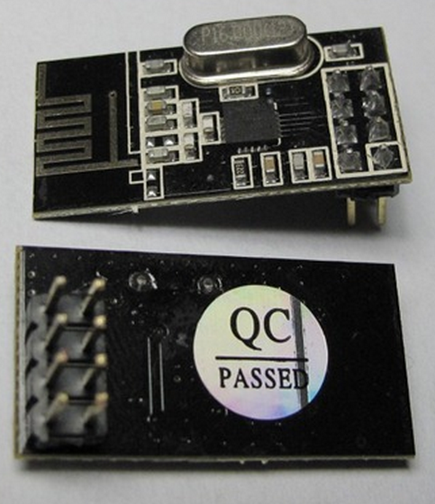
nRF24L01 Transceiver
Uses 2.4 GHz ISM band
Less than $2 per unit on eBay
2 Mbps transmission speed
SPI MCU interface
approximately 1.5” x .75”

Slide 21
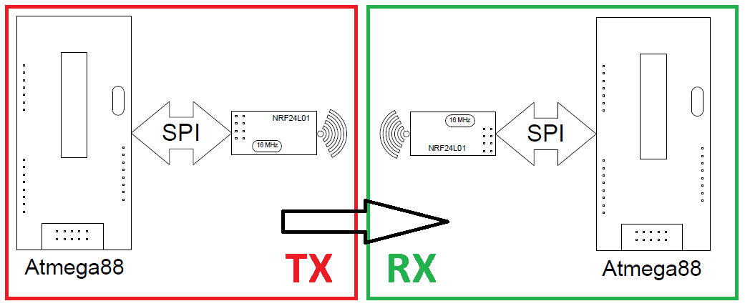
nRF24l01 C Library
Provides layer of abstraction to nRF hardware
Transmit_payload() sends two bytes to receiving unit
In receiving unit, nRF sends interrupt signal to the MCU, telling it a message has been received from the hand module
Can check if transmission was successful and retry as needed, but have not implemented this yet.

Slide 22
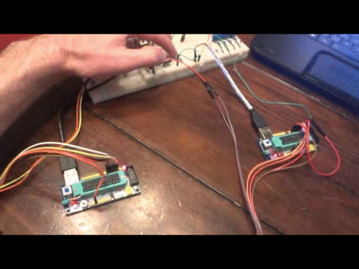
Ping!

Slide 23
Powering The Hand Modules
Will use readily available, rechargeable Li-Ion batteries
Will need to provide both 5V and 3.3V power rails
Low battery indicator LED will alert user when to change the battery
Battery will be easily swapped when needed

Slide 24
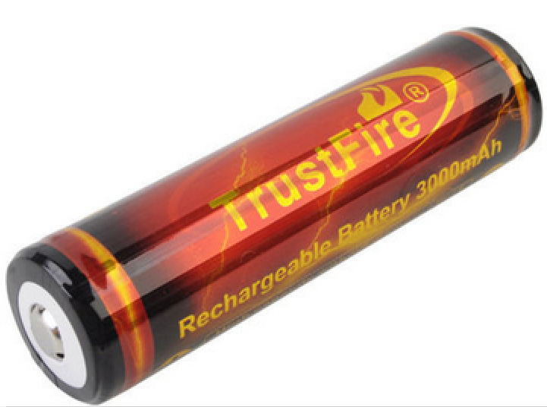
18650 Li-Ion Batteries
Over-charge, over-discharge, and thermal protection from onboard IC
3.6V or 3.7V advertised nominal voltage
4.2V fully charged, 3.0V fully discharged
reported 2800 mAh actual capacity
$10 for two from eBay, with a charger
~25% bigger than AA battery

Slide 25
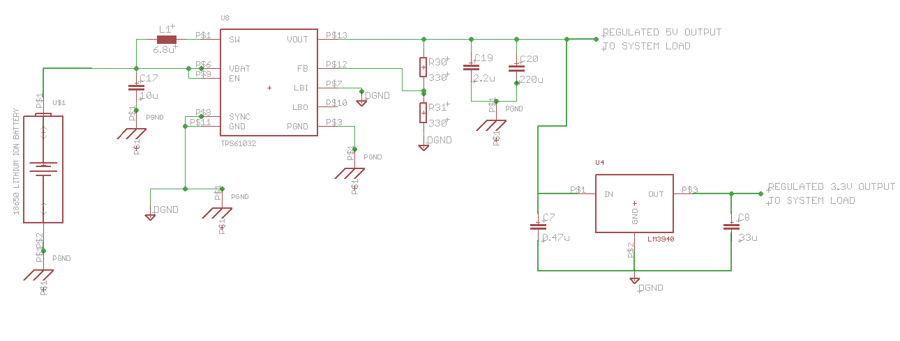
TPS61032
DC to DC boost switching regulator, up to 2A capability
creates 5V supply rail regardless of the 18650 battery voltage
3.3V parts are then powered from LM3940 LDO IC

Slide 26
Hand Module PCB
Must fit inside one of a few chosen clear enclosures
Will use 1206 (1.6mm x 3.2mm) or larger SMD components
Will not use any “no leads” packages for fear of unseen solder bridges
FPGA and nRF24l01 boards will plug into Hand Module PCB through female headers
ATmega88, DG509, OPA4350 (x2), ADC0820 (x2), SN74LVC245 (x3), TPS61032, and LM3940 ICs will be reflowed onto PCB using a heat gun and solder paste.

Slide 27
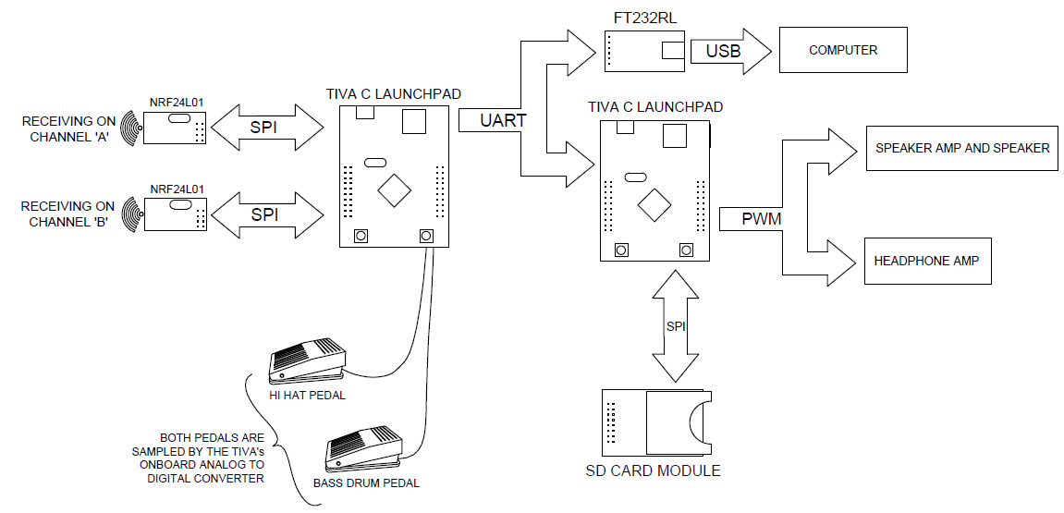
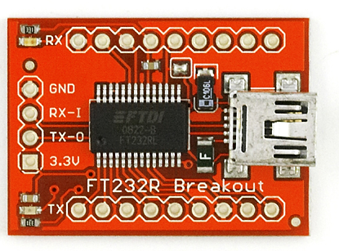
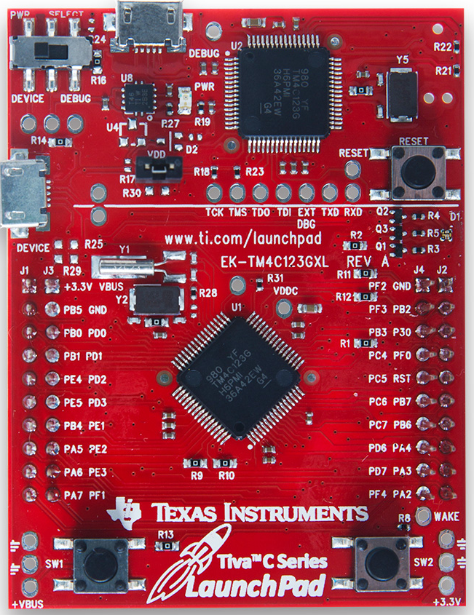
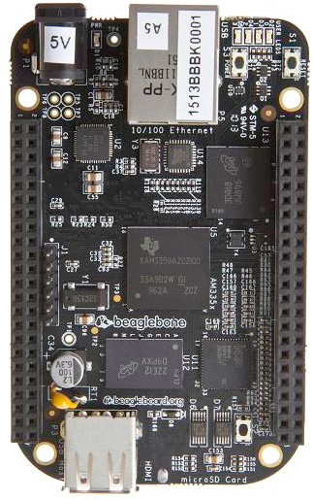
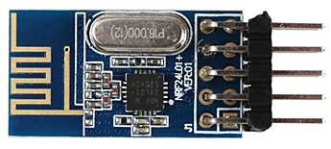
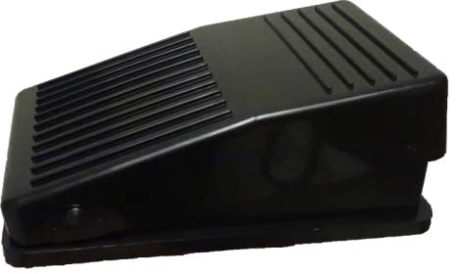
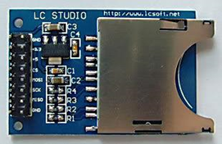
Inside the Tabletop Module

Slide 28
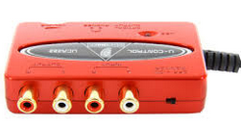
Beaglebone Over Tiva C
Few MCU examples playing CD quality audio
Beaglebone can connect with a USB sound card
Beaglebone Black is cheaper than some less powerful MCUs, otherwise we would not use an OS
No doubt will be able to mix CD quality audio in real time

Slide 29
The Bass Drum Pedal
Piezo sensor glued to bottom of pedal housing is struck by plastic angle bracket mounted to top of housing when pedal is depressed
Velocity determined similarly to in the hand modules except code is written in C

Slide 30
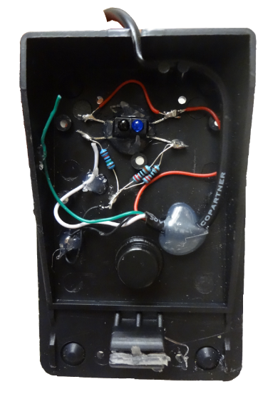
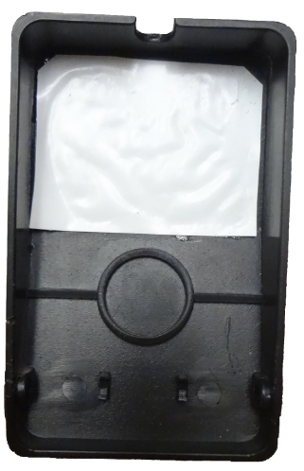
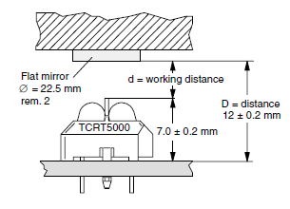
The Hi Hat Pedal
Uses TCRT5000 IR Proximity sensor
2.0V output fully depressed, 0V output when pedal is open
linear response from 0 to 2V
range can be improved

Slide 31
Hitting the Hi Hat Cymbal
if(hi hat cymbal hit)
{send pedal position before hit info}

Slide 32
The “Foot Chick” Sound
Closing the pedal quickly creates the “foot chick” sound

Slide 33
The “Foot Splash” Sound
Opening the pedal quickly creates the “foot splash” sound

Slide 34
Creating MIDI Messages
Must combine data from four sources
Left Hand Module: hit info
Right Hand Module: hit info
Bass Drum Pedal signal: hit info
Hi Hat Pedal: position, chick, and splash info
MIDI output will include all the data necessary to create most sounds an acoustic set can make

Slide 35
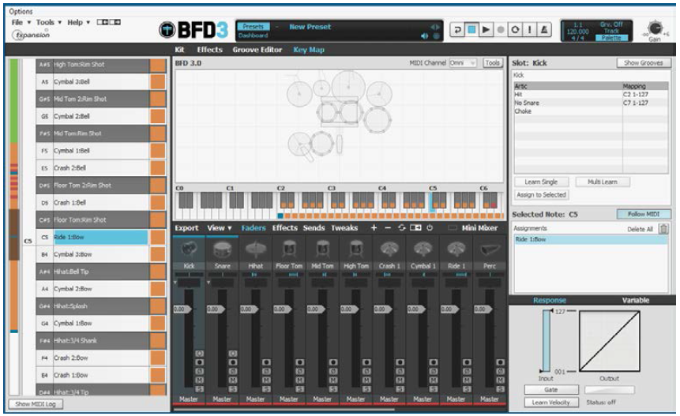
Glove Drummer and BFD3
LoopMIDI and Hairless MIDI/Serial software route messages to BFD3 software allowing messages to be sent at 3x the standard MIDI baud rate of 31,250 bit/s
Flexible mapping from sensor to drum inside of BFD3 or other drum software

Slide 36
Onboard Audio Playback
BeagleBone Black will be interfaced to UCA-222 USB soundcard to support low latency polyphonic audio playback
16 bit 44,100 Hz *.wav files stored in onboard microSD
Users can load their own sounds to the microSD from their computer

Slide 37
Audio Files
Each drum or cymbal will have many different sounds stored on the Beaglebone’s onboard microSD card
Velocity determines which sound is added to the mix
In the case of a hi-hat hit, both pedal position and velocity determine the appropriate sound to play

Slide 38
Polyphony
Multiple sounds will need to be played through the speaker simultaneously
Individual samples must be added together without clipping
Levels will be attenuated before storing onto SD card to avoid clipping
Additional software normalization may be used

Slide 39
The Speaker Enclosure
Includes speakers and speaker amp
The transformer and rectifier will be replaced by laptop power supply to create space for circuitry
Linear Voltage Regulators will be used to power the 5V and 3.3V parts

Slide 40
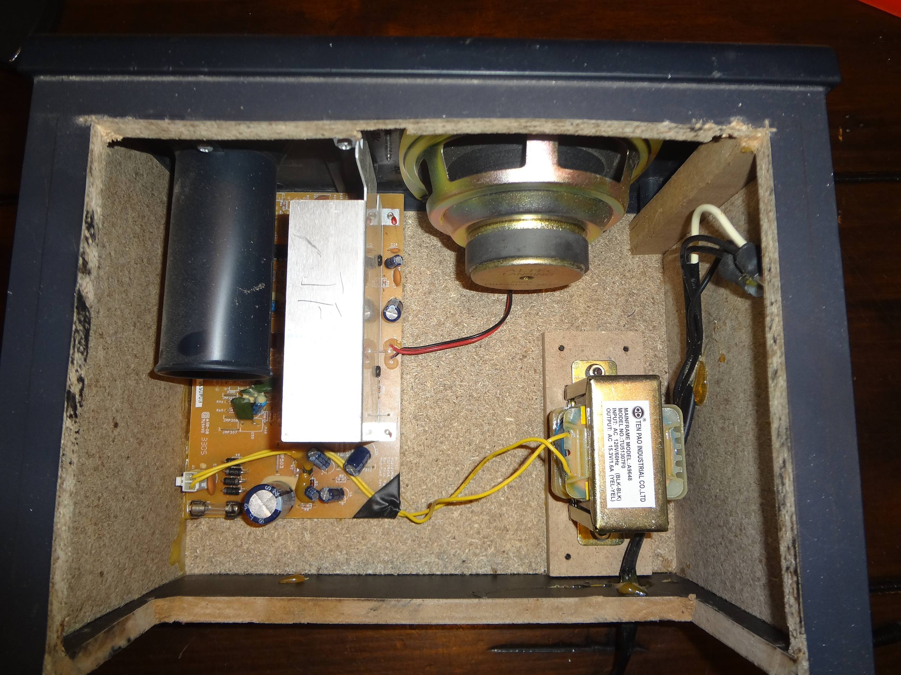
The Speaker Enclosure

Slide 41
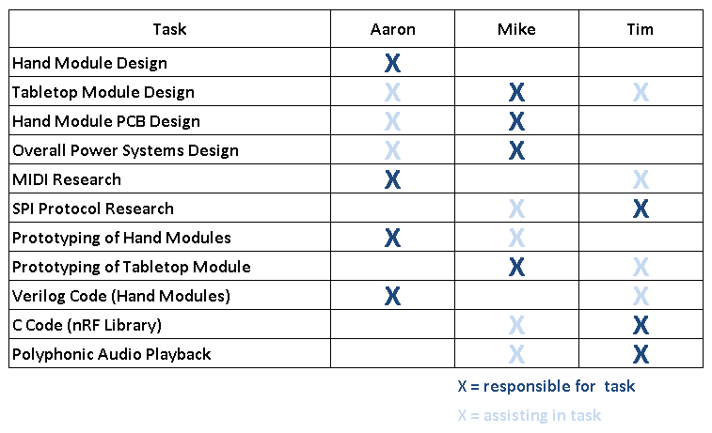
Division of Labor

Slide 42
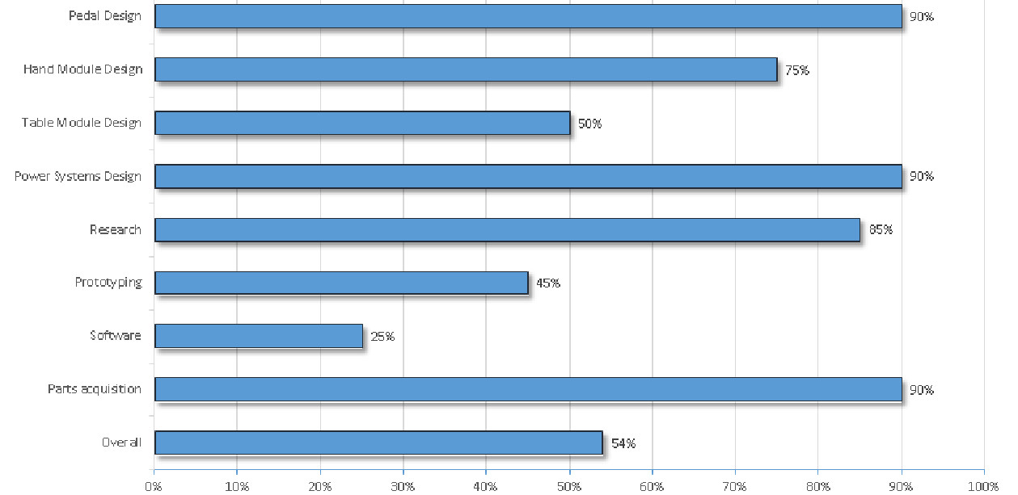
Progress

Slide 43
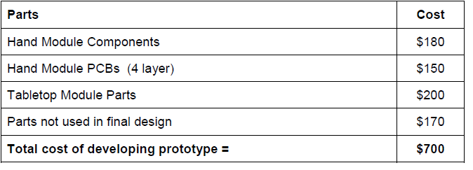
Projected Budget

Slide 44
Issues
Dynamic range of piezo signal needs some improvement
New to Linux and Beaglebone black

Slide 45
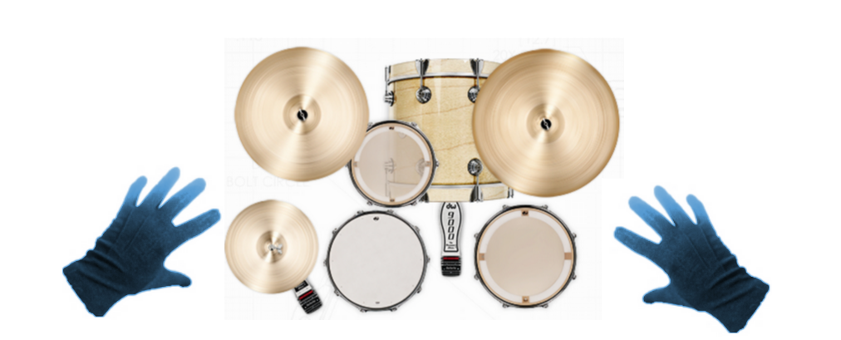
Questions?

